Slide 1




Introducing Azure DevOps Server 2019 RC1
Santhakumar Munuswamy
Senior Technical Lead, Certified Scrum Master
http://san2debug.net
@msanthakumara
santhakumarmunuswamy

Slide 2


About
Around 12 year’s experience in IT Industry.
Expertise in .NET, DevOps, Agile etc.
Author, Speaker, MVP
My Blog: http://san2debug.net
Follow me on
@msanthakumara
santhakumarmunuswamy

Slide 3
Agenda
Roadmaps of TFS
About Azure DevOps Server
What is Azure DevOps Server
Difference b/w Azure DevOps Server and Azure DevOps Services
What’s New in Azure DevOps Server
Azure DevOps Services
Requirements
Licensing and Upgrading
Demo
Recap and Q&A

Slide 4
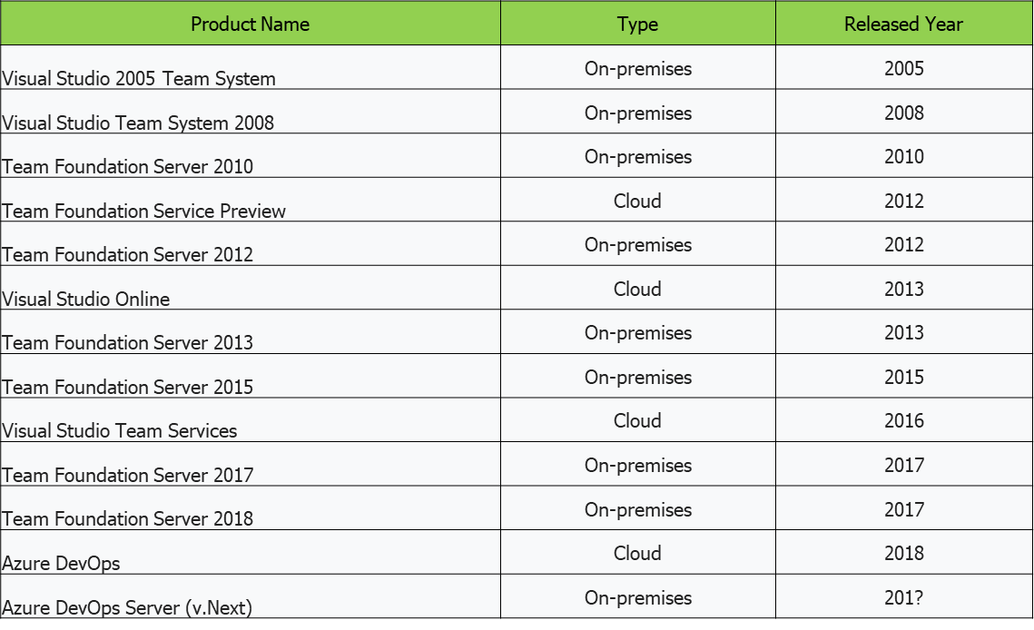
TFS Roadmaps

Slide 5

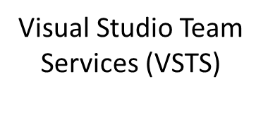
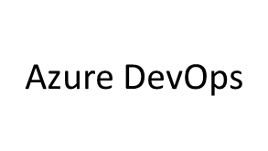
Roadmaps

Slide 6
About Azure DevOps Server
Microsoft released the first release of Azure DevOps Server 2019 RC1 on November 19, 2018.
Azure DevOps Server is the new name for the on-premises DevOps server product previously called Team Foundation Server.
It is on-premises version of Azure DevOps Services.
It provides integrated tools to support collaborative software development, including Git repositories, continuous integration and continuous deployment and interactive Kanban boards.
Express edition is free for individual developers or teams of five member or fewer, at no cost.

Slide 7
What is Azure DevOps Server?
Azure DevOps Server is a set of collaborative software development tools, hosted on-premises. Azure DevOps server integrates with your existing IDE or editor, enabling your cross-functional team to work effectively on projects of all sizes.

Slide 8
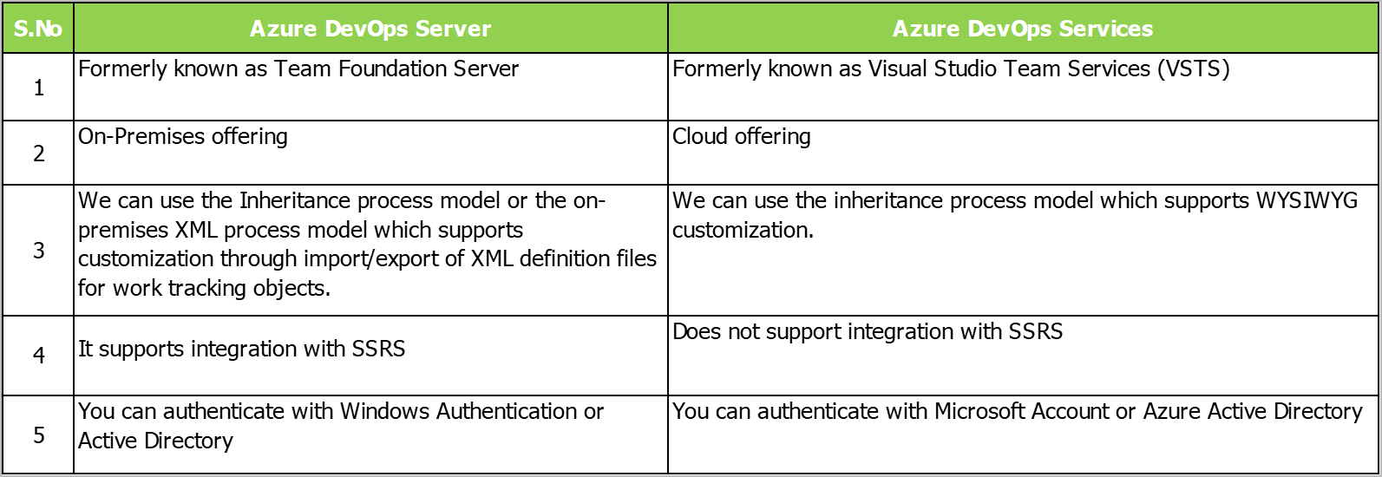
Azure DevOps Server vs Azure DevOps Services

Slide 9
What’s New in Azure DevOps Server 2019 RC1
General
New navigation experience
Support for Azure SQL Database
Process inheritance on new collections
Expanded Search box
My work flyout
Boards
New Work Items hub
New Boards, Backlogs and Sprints hubs
New Queries hub
Sprint planning features
New Directory pages
New View Options menu
Move work using suggested Areas and Iterations

Slide 10
What’s New in Azure DevOps Server 2019 RC1
Repos
Receive notifications when pull request policies are bypassed
Standardize pull request descriptions using templates
Change the target branch of a pull request
Pipelines
Manage build pipelines using the new Builds page
Manage release pipelines using the new Releases page
Visualize release progress
Reporting
The Analytics marketplace extension for reporting is now available

Slide 11
Azure DevOps Services
Azure Boards
Agile tools (plan, track and discuss work across your teams)
Azure Pipeline
Build, test and deploy with CI / CD that works with any language, platform and cloud.
Azure Repos
Get unlimited, cloud-hosted private Git repos and collaborate to build better code with pull requests.
Azure Test Plans
Test and ship with confidence using manual and exploratory testing tools.
Azure Artifacts
Create, host and share packages with your team and add artifacts to your CI / CD pipeline with single click.
Extension Marketplace
Access extension from Slack to SonarCloud to 1,000 other apps and services build by the community

Slide 12
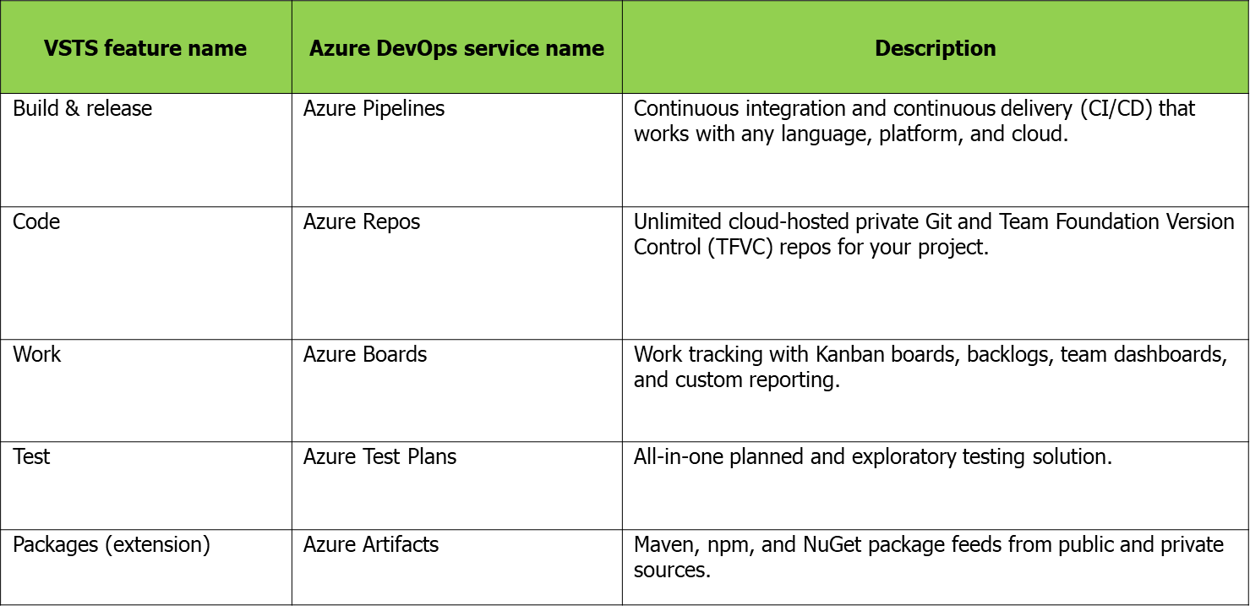
VSTS Features are now separate Services

Slide 13
Requirements
Server systems requires
Azure DevOps Server 2019 RC1
Windows Server 2019 / 2016
Client systems requires
Azure DevOps Server 2019 RC1
Windows 10 (Professional, Enterprise) version 1607 or greater
SQL Server
Azure DevOps Server 2019 RC1
SQL Server 2017 / 2016 (SP1)

Slide 14
Licensing and Upgrading
Azure DevOps Server 2019 requires
Azure DevOps Server license
Windows Server license
Client Access license (CAL)
Upgrade
Azure DevOps Server is supported from any version of TFS, which includes Team Foundation Server 2012 and newer.

Slide 15
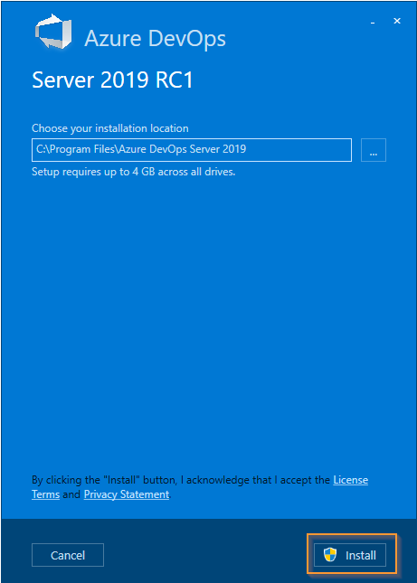
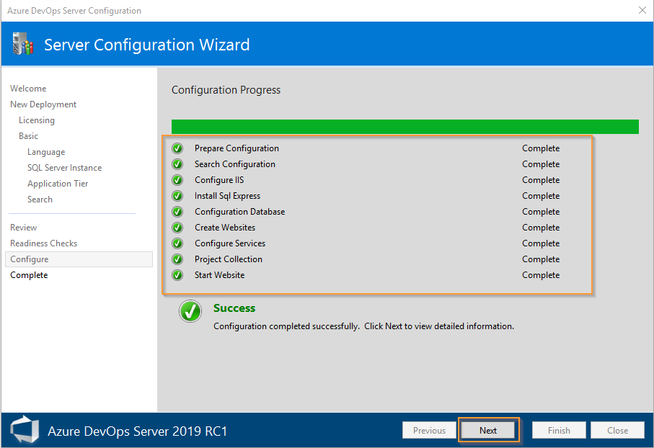
Installation

Slide 16
Demo
Azure DevOps Server 2019

Slide 17
Recap and Q&A
Azure DevOps Server 2019

Slide 18


Contact
Follow me on
Follow us on
@msanthakumara
santhakumarmunuswamy
Santhakumarm.munuswamy
@san2debug
san2debug
https://www.youtube.com/channel/UChU0DXw-Oyd5926bcEWB_3w

